Slide 1
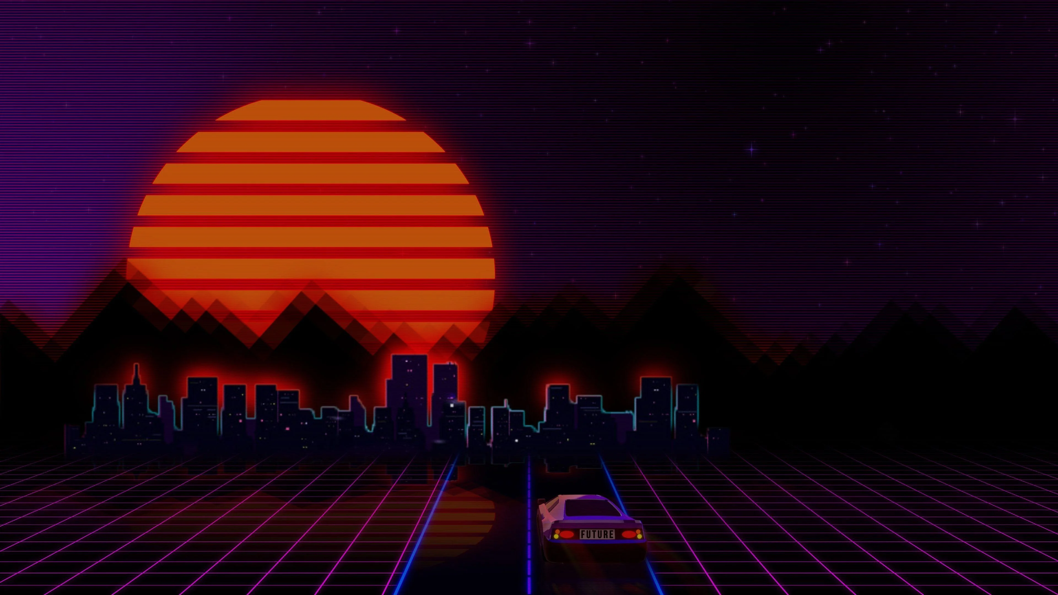
Retro Gaming Console using Raspberry Pi Zero 2 W
Presented by: cheick moctar Traore
Date: 29/04/2025

Slide 2
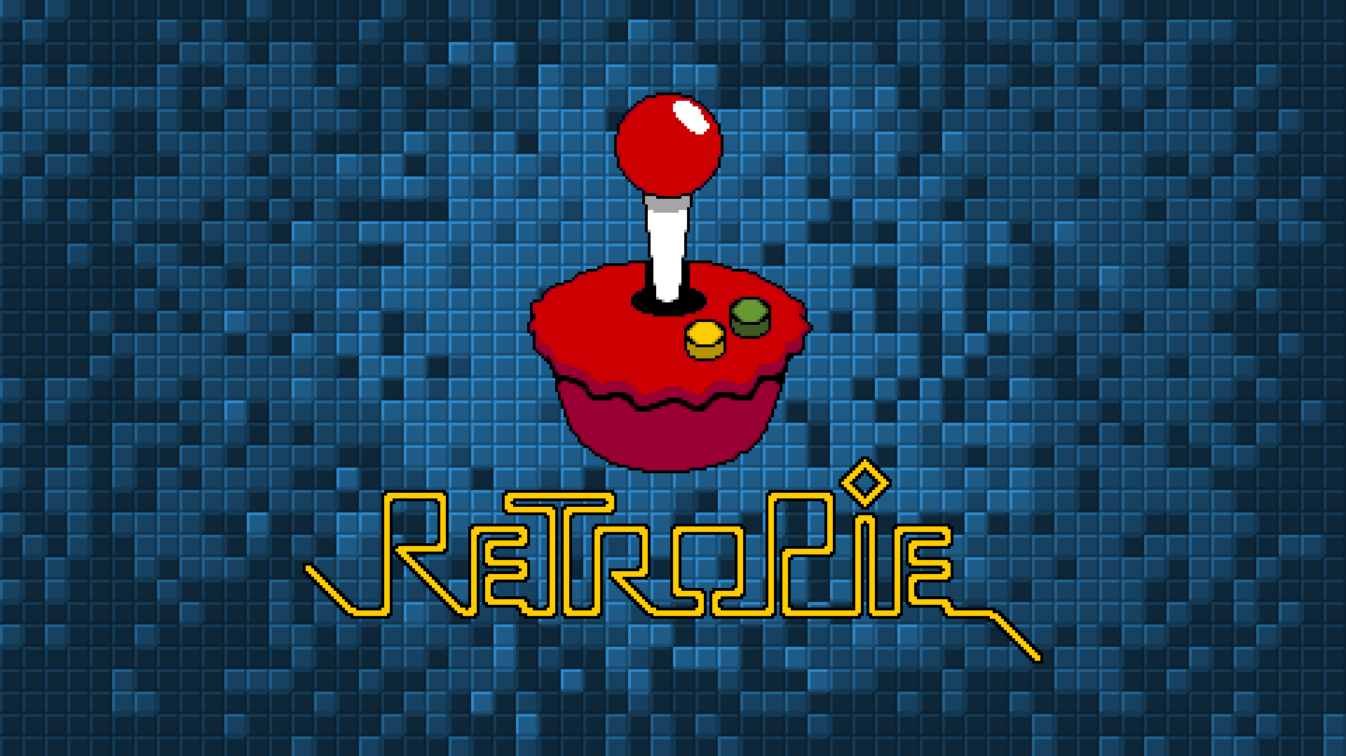
Introduction
What is retropie?
RetroPie is a software package that lets you turn a Raspberry Pi into a retro gaming console. It regroups together emulators (programs that mimic old gaming consoles) and provides an easy-to-use menu system where you can browse and launch your classic games .
Why Raspberry Pi Zero 2 W?
_RetroPie is built on top of the Raspberry Pi because the Raspberry Pi is small, cheap, and powerful enough to run old games.
_Raspberry Pi uses Linux, which is open-source, making it perfect for free software projects like RetroPie.
_Raspberry Pi is very affordable, so anyone can build a retro console without spending much money.

Slide 3
What are the Benefits of RetroPie?
Wide Emulator Support: RetroPie supports a massive number of consoles (NES, SNES, PlayStation 1, N64, Sega Genesis, Atari, etc.) — all from one place.
Free and Open Source: You don’t have to pay for RetroPie itself, and you can modify it however you like
Performance: RetroPie is highly optimized for Raspberry Pi models (especially Pi 3, 4, and Zero 2 W) — meaning better performance and less lag compared to some alternatives.

Slide 4

Technology used
Raspberry Pi OS Legacy 32-bit
SSH Access: cmd
VNC Access: RealVNC Viewer
File Transfer: WinSCP (secure copy protocol)
Gaming Platform: RetroPie, EmulationStation

Slide 5
Hardware and System Architecture
Raspberry Pi Zero 2 W
64GB MicroSD Card
Power Supply (5V 2.5A)
Bluetooth Game Controller
Wi-Fi Network

Slide 6

Implementation Process - Part 1
Flash
Flash OS onto SD Card
Enable
Enable SSH and Wi-Fi
Connect
Connect via CMD (SSH)
Update and upgrade
Update and upgrade system

Slide 7

Implementation Process - Part 2
Clone RetroPie Setup Script
Basic install of RetroPie
ROMs added using WinSCP into /RetroPie/roms/

Slide 8
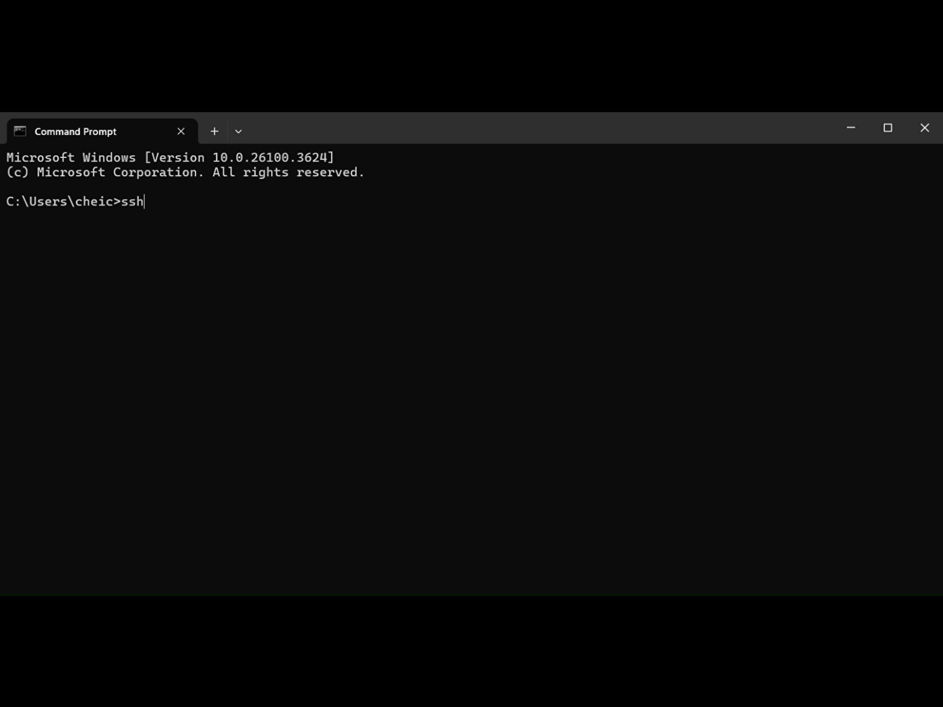
Demo:

Slide 9

System Evaluation: Challenges
Black screen issue on EmulationStation startup
Crashes when loading too many games
Retropie does not have a desktop environment
Could not install OS 64bit and 32bit ( was working but lagging too much)

Slide 10
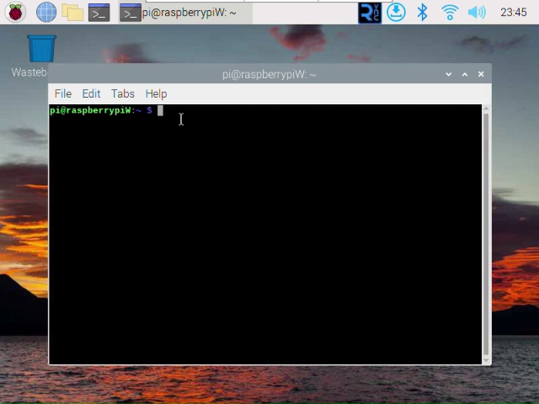
demo

Slide 11
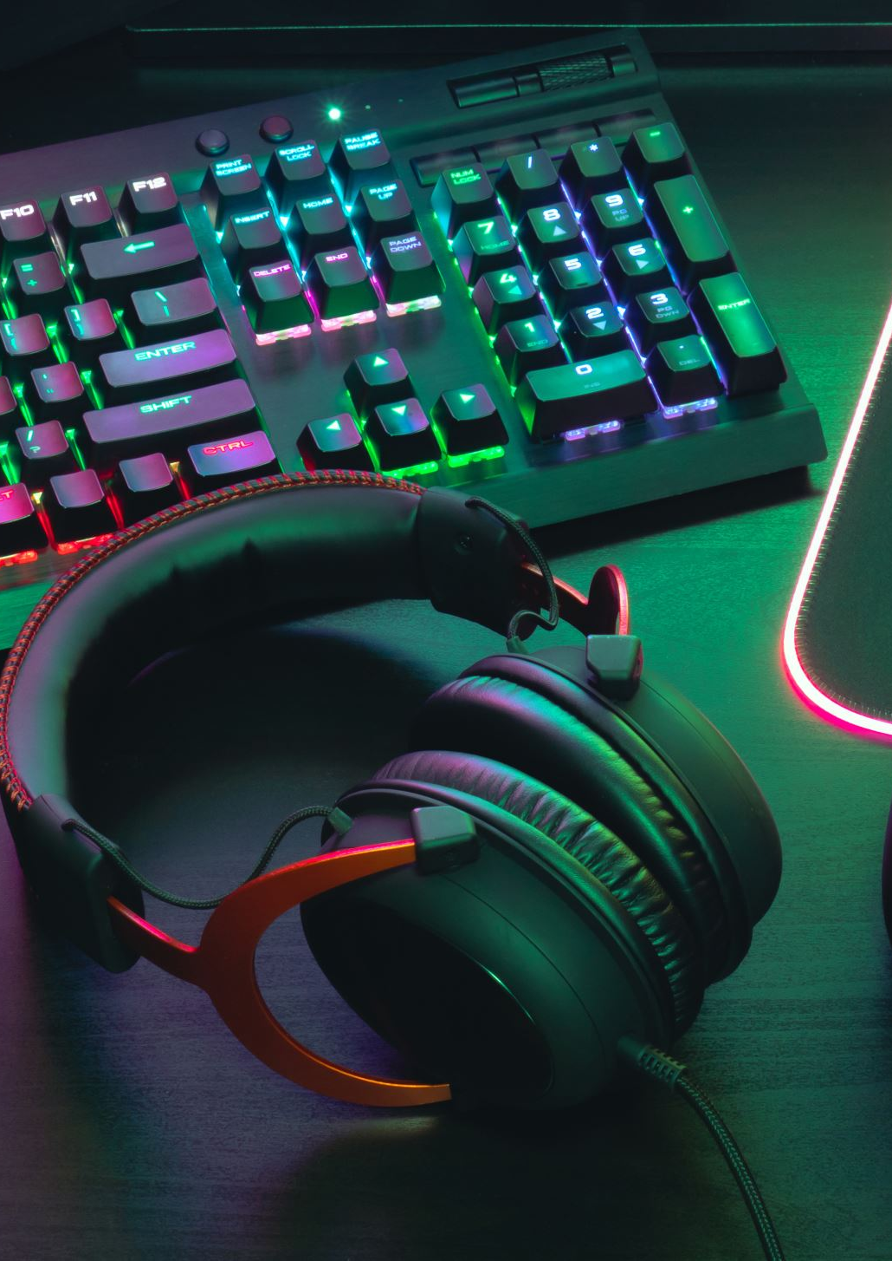
Solutions Implemented
Causing the Black Screen?
running EmulationStation over SSH
EmulationStation requires a real display or a virtual framebuffer It can’t run directly over SSH because it needs a graphical framebuffer.
2. No display is plugged in :
If you don’t have a monitor connected, EmulationStation will try to start but fail silently with a black screen or crash.
Solution:
Forced HDMI output fix in /boot/config.txt:
_hdmi_force_hotplug=1
_hdmi_group=2
_hdmi_mode=87
_ hdmi_cvt=800 600 60 6 0 0 0
Adding games one at a time
Adding retropie on top of OS 32bit legacy

Slide 12
THANK YOU

